Slide 1
SWD Wordle Project
Made by the beautiful individuals….
Samuel Maschmann, Nathaniel Narunatvanich,
and Samuel Nicklaus

Slide 2
Overview
Technical Features
GUI
Client-Server Relationship
Database
Demo

Slide 3
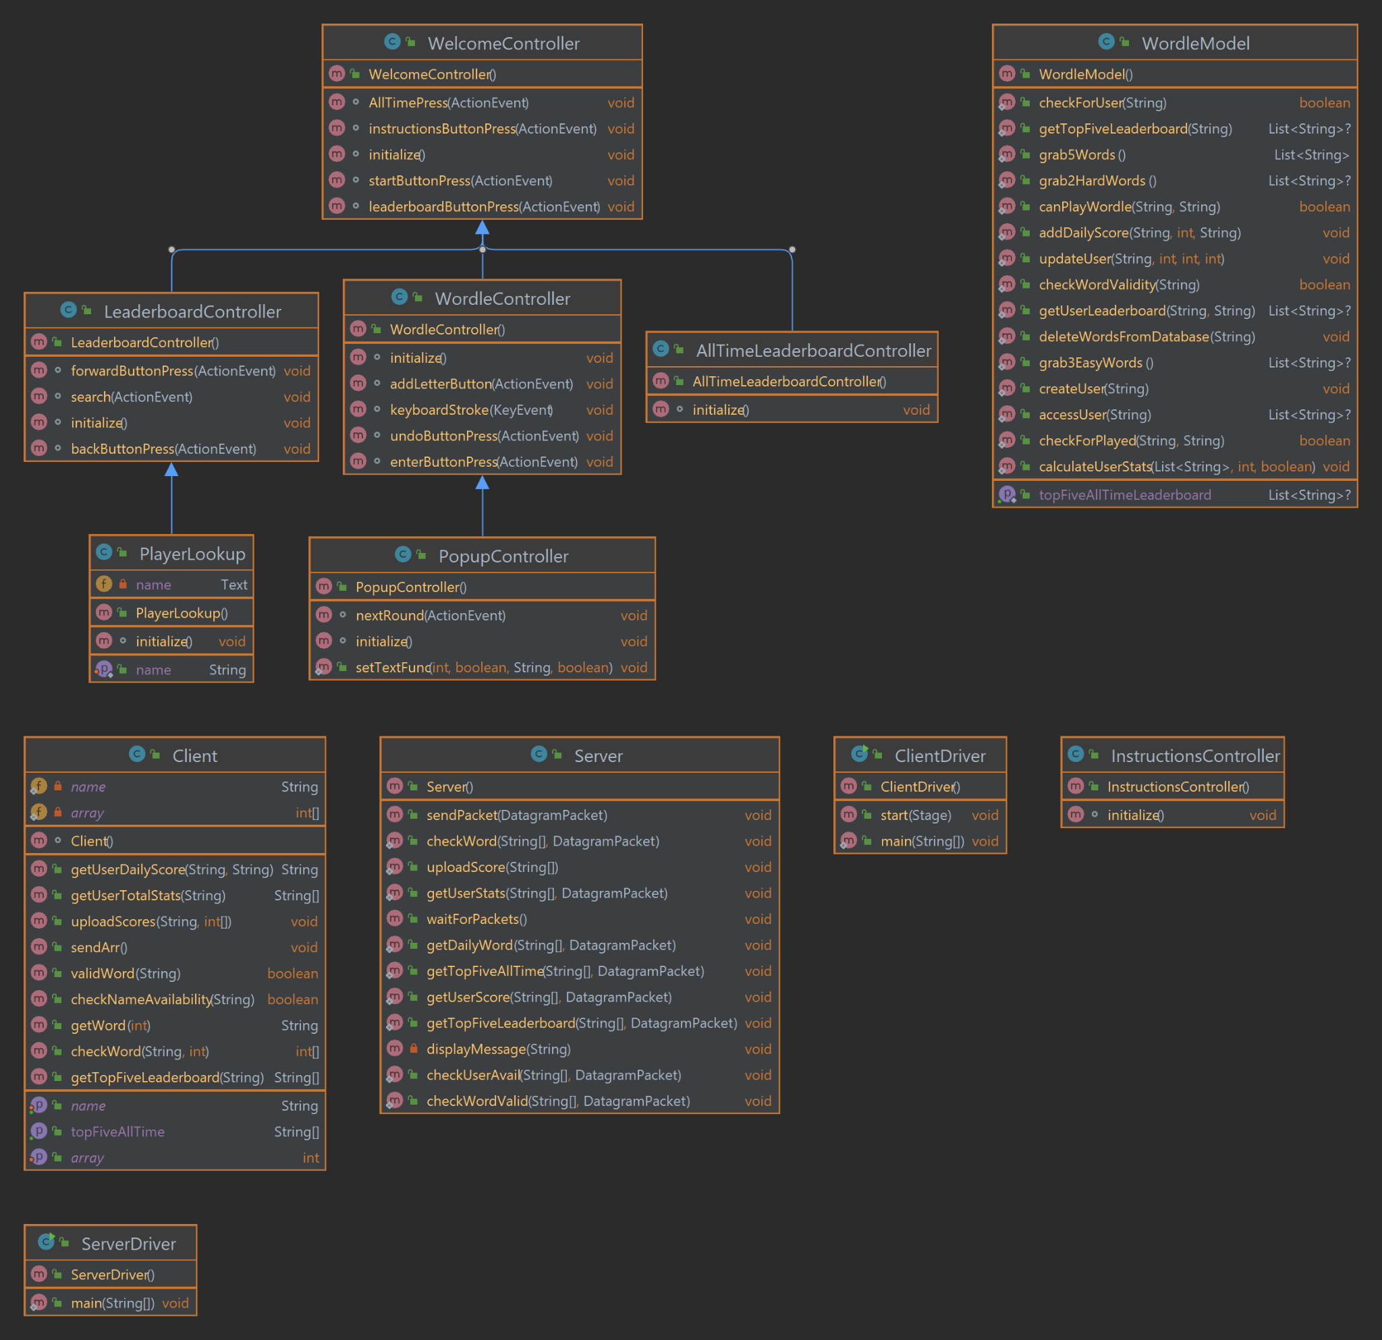

Slide 4
Technical Features
SQL to store databases
Score is calculated by word complexity
Daily leaderboard
All time leaderboard
Player lookup tool
Cool GUI features
Login System

Slide 5
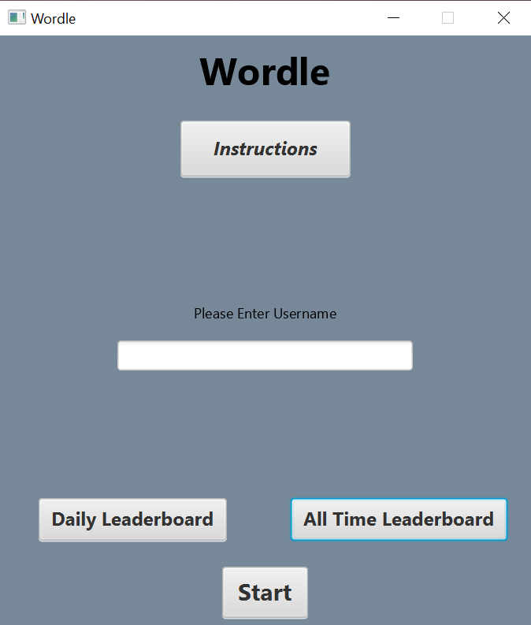
GUI

Slide 6
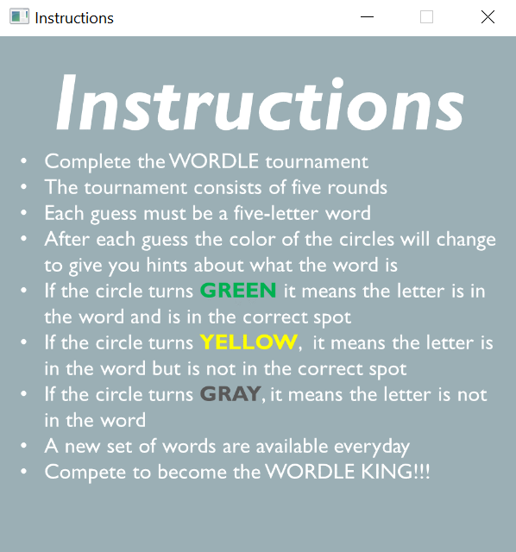
GUI

Slide 7
GUI

Slide 8
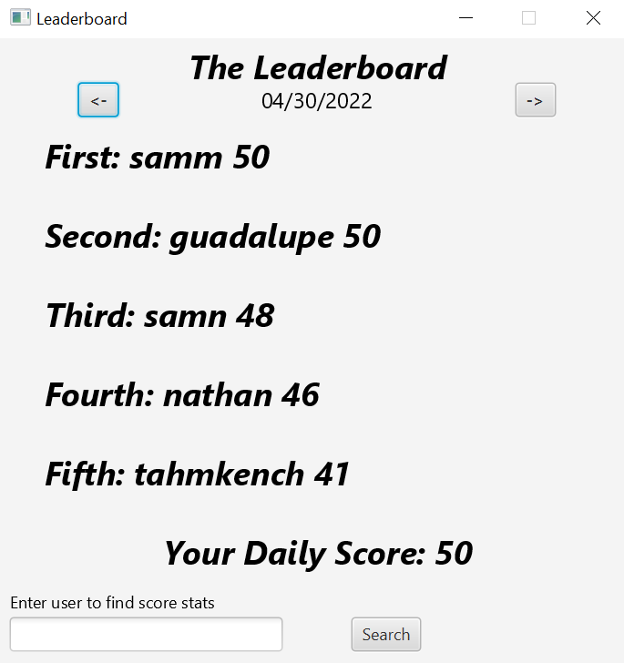
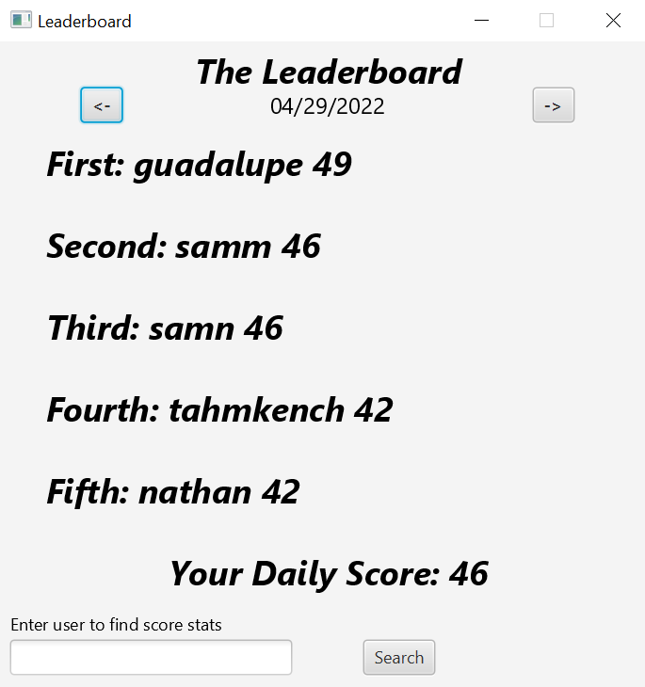
GUI

Slide 9
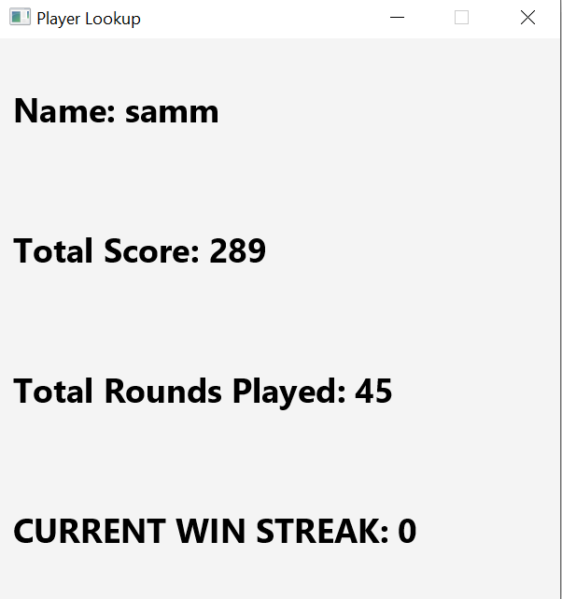
GUI

Slide 10
GUI

Slide 11
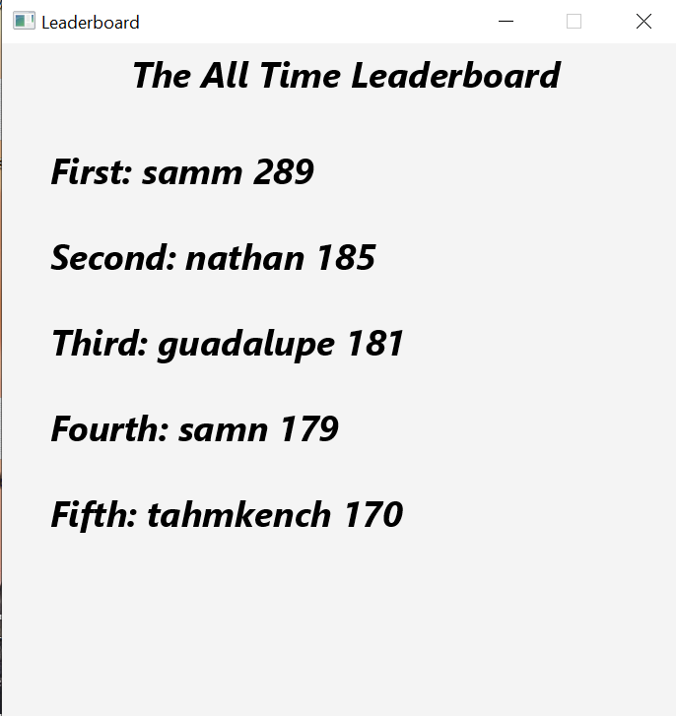
GUI

Slide 12
GUI

Slide 13
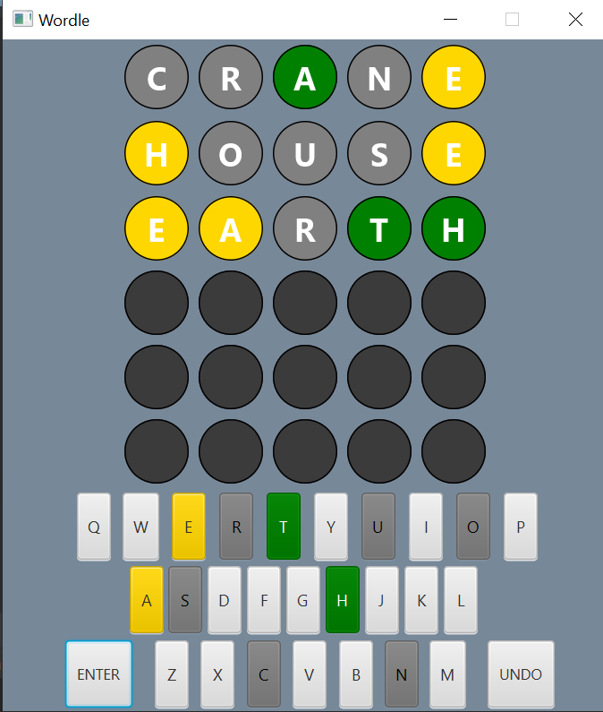
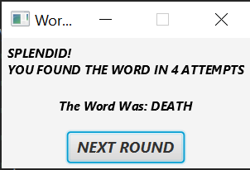
GUI

Slide 14
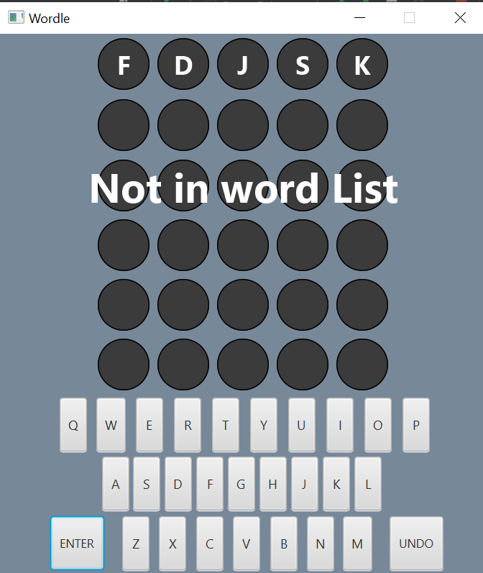
GUI

Slide 15
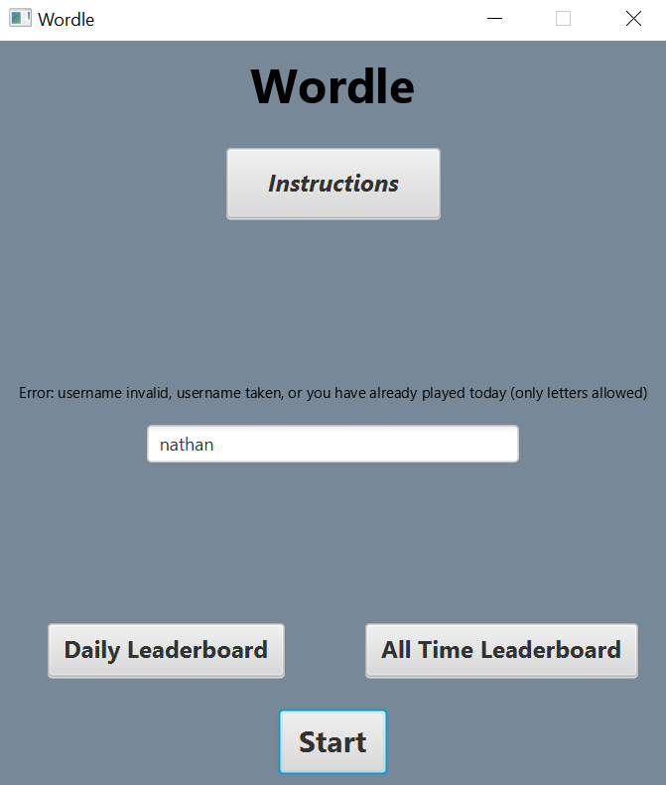
GUI

Slide 16
Client Server Relationship
Client
SQL Database
Packets
Queries
Server
Packet-Based Communication
Signifiers in Packets
2 -> Check Word
Check with Database through Queries
Notes:
Our program relies on a packet-based communication system to send and retrieve data. When the client needs to get information from the database or upload a score, it calls a method that sends a packet to the server containing a signifier integer and some data separated by a comma. The signifier is an integer ranging from 1-9 that corresponds to a method in the server. The server reads this number and calls the proper method. For example, a signifier of 2 will call the check word method in server which takes a string for the data in the packet and returns a string telling which letters are green, yellow, or grey. It then sends or retrieves data from the database through queries, and finally sends the necessary data back to the client in a packet.

Slide 17
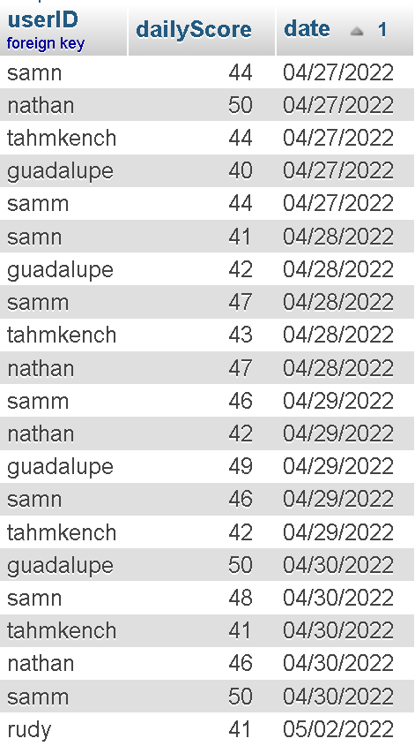
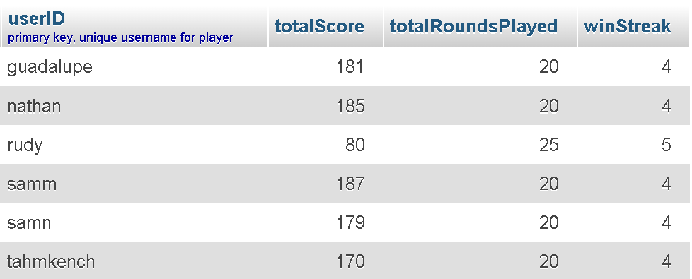
SQL Database
4 tables: users, dailyScores, validWords, wordBank
Notes:
This program utilizes a mySQL database server to store and create user information, as well as the words used in the WordleTournament game; our database has 4 tables.
The users table is where users register a unique primary key userID to store their game stats. These values are called when the all-time leaderboard is displayed, or when the specific userID is called in the user lookup function. New users are inserted in this table, and player stats are updated after the Wordle game ends.
The dailyScores table is where each user’s score for each day of playing the WordleTournament is stored; userID serves as a foreign key to tie the entries back to each user. These values are called when the daily scores leaderboard is displayed. This table is also used to check if a user has played the Wordle on the current day by attempting to call an entry with the user’s userID and the current date.

Slide 18
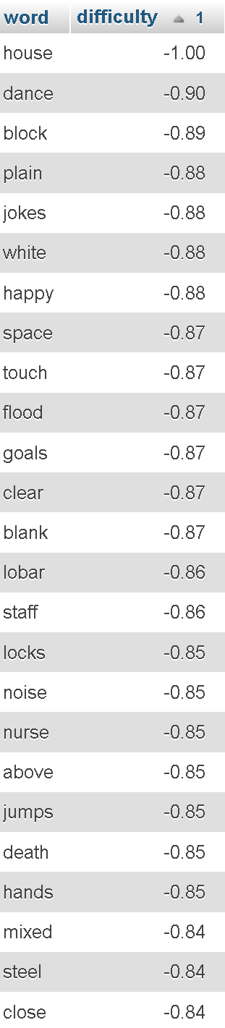
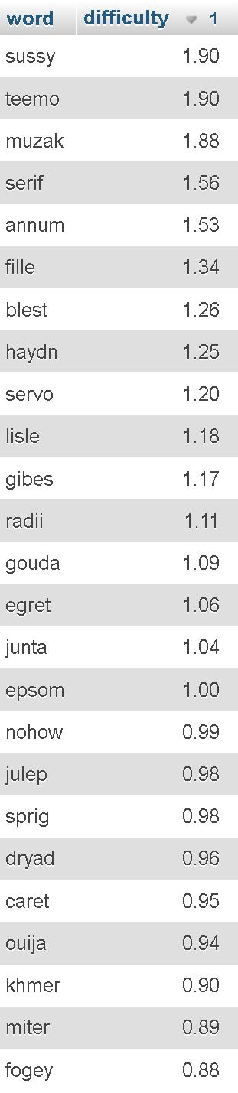
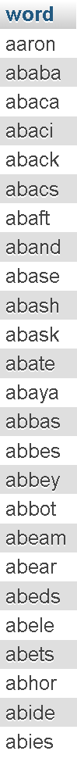

SQL Word Tables
Notes:
The wordBank table stores all of the potential 5 letter word solutions for the game; each word is unique and has a specified numerical difficulty (between -1 and 2). This difficulty was determined via machine learning methods that analyzed the complexity and frequency of the word in modern media. The first three rounds use words with a difficulty between -1 and 0 and the latter two rounds use words of a difficulty above 0. This index is used as a multiplier for our score calculations.
The validWords table consists only of 5 letter words, and is used to validate that the word guessed by the user is a valid word. The user input is used to call an entry in this table in order to validate that the word is real.

